Slide 1

COVID-19 Dataset Analysis

Slide 2
His details

Slide 3
DESCRIPTION
The dataset is about COVID-19 Cases and Deaths. The main objective of this project is to analyze the data completely and to answer some of the questions, so that some companies or executive persons can take some important decisions based on the insights.
The main focus of the project is on Manipulation and Visualization of Geographical distribution of COVID-19 cases throughout the world

Slide 4
Data Cleaning
Removed some columns which are not relevant.
Removed null values.
Removed negative number of cases and deaths.
Some columns renamed.
After new dataset downloaded.
Power BI is used to visualize the data.

Slide 5
Tools used
Feature Selection
Python
Excel
Power Query
Power BI

Slide 6
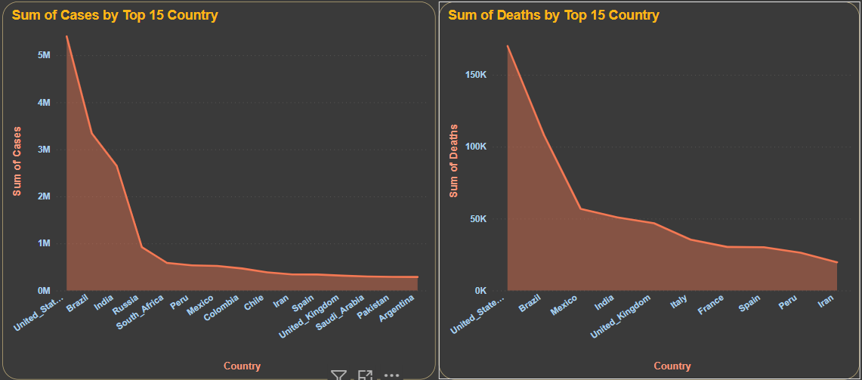
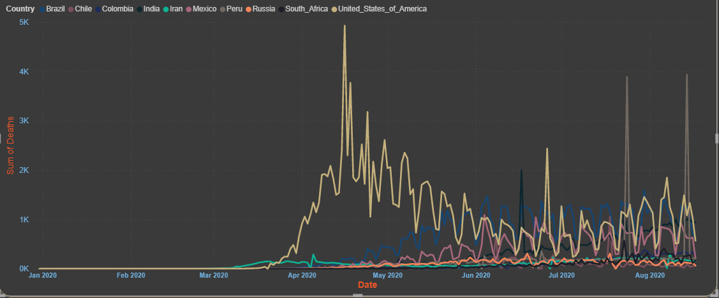
Do the curve of cases and deaths have an upward trend globally ?
QUESTION - 01
Yes, you can see both the graphs, the curves are in upward trend.
As you can see in USA, for 5.5M cases, the death rate is almost 3-4%. On an average 736.16 deaths are happening.
Sometimes both death and cases are increasing and sometimes both are decreasing.
But slowly both the cases and the death rate are decreasing over a period of time.

Slide 7
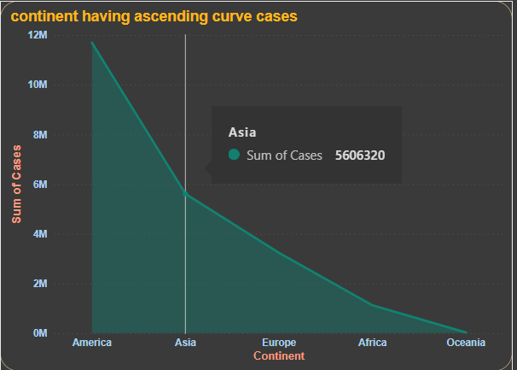
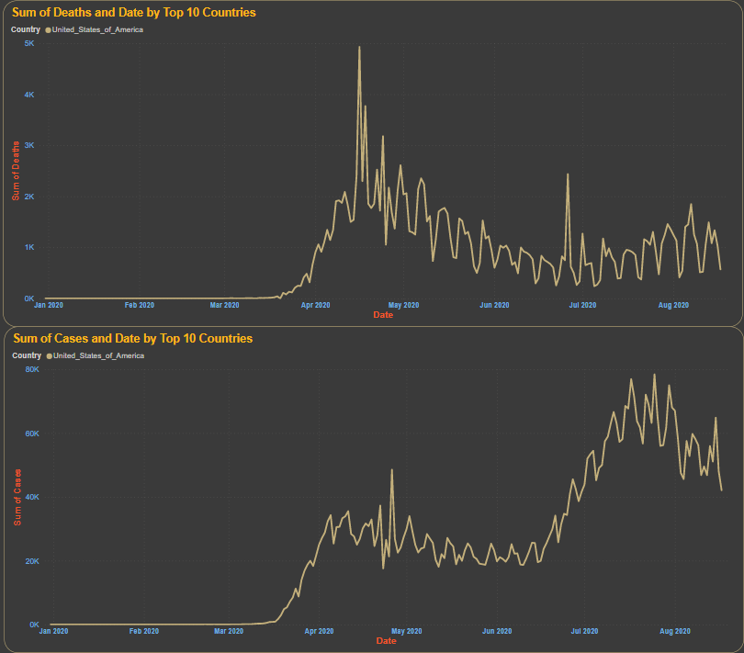
Does any continent have a distinct ascending curve of cases ?
QUESTION - 02
You can see the above graph. America has the highest cases compared to other continents.
In America, between April to June, both COVID cases and deaths are high.
After from June, only COVID cases are increasing and death rate is actually fluctuating, but it tends to decreasing.
Gradually over a period of it came to normal.

Slide 8
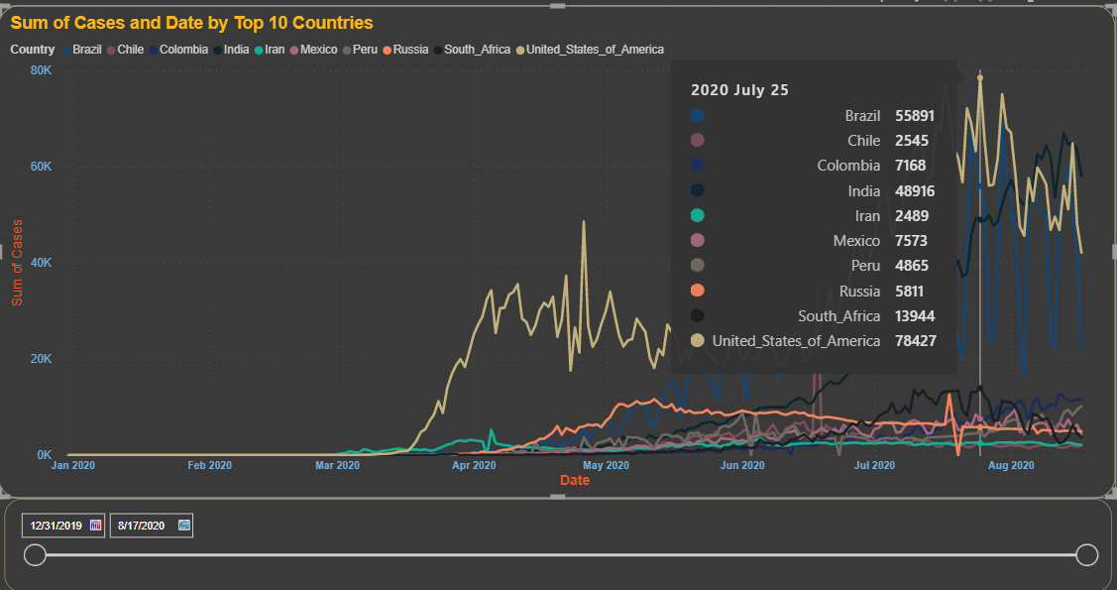
What date was the highest daily number of new cases ? In which country ?
QUESTION - 03
25 JULY 2022. On this day USA has recorded highest number of COVID cases that is almost 78.5k cases in a single day.
The graph is started increasing from 15 JUNE 2022 and has recorded highest number of cases throughout the world.

Slide 9
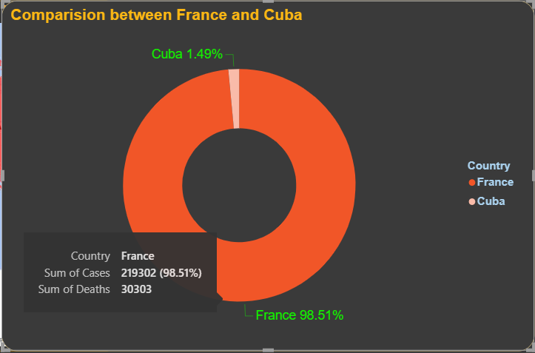
Does the epidemiological situation in France differ in comparison to Cuba ?
QUESTION - 04
You can observe the number of COVID cases and the deaths of both France and Cuba countries in this donut chart.
98.5% of both COVID cases and death rate of France is higher compare to the Cuba country, that is very huge count.
And may be more population is also a reason for that huge difference.

Slide 10
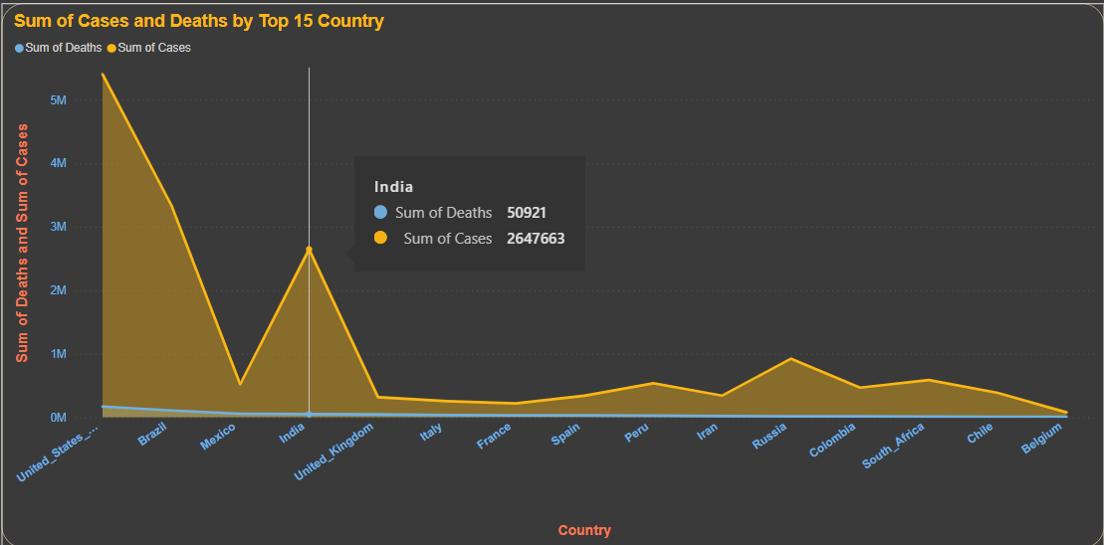
Chart

Slide 11
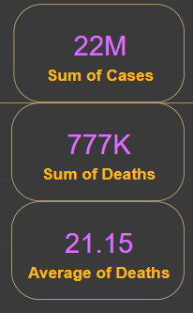
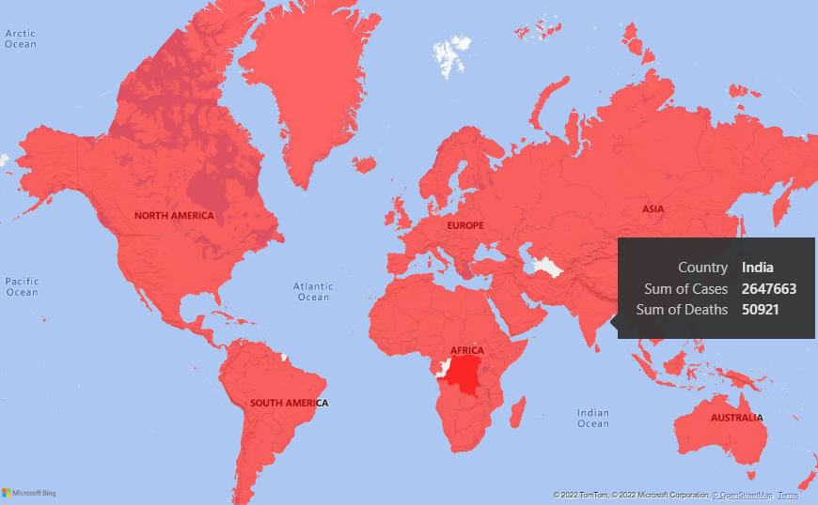
CHART
Throughout the world

Slide 12
Thank You

